Slide 1

SIT1304
CLOUD COMPUTING
BY
Ms. B. KEERTHI SAMHITHA & Ms. SUJA. C. M
Assistant Professor
Department of CSE

Slide 2
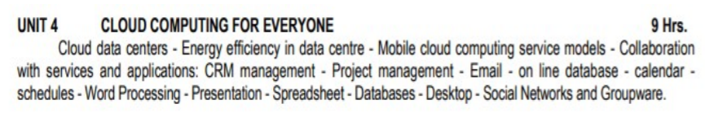
UNIT 4
CLOUD COMPUTING FOR EVERYONE

Slide 3
CLOUD DATA CENTERS
A data center (or datacenter) is a facility composed of networked computers and storage that businesses or other organizations use to organize, process, store and disseminate large amounts of data.
A business typically relies heavily upon the applications, services and data contained within a data center, making it a focal point and critical asset for everyday operations.

Slide 4
CLOUD DATA CENTERS
Data centers are not a single thing, but rather, a conglomeration of elements.
A data center must also contain an adequate infrastructure, such as power distribution and supplemental power subsystems, including electrical switching; uninterruptable power supplies; backup generators and so on; ventilation and data center cooling systems, such as computer room air conditioners; and adequate provisioning for network carrier (telco) connectivity.
All of this demands a physical facility with physical security and sufficient physical space to house the entire collection of infrastructure and equipment

Slide 5
WHAT IS A DATA CENTER?
At its simplest, a data center is a physical facility that organizations use to house their critical applications and data.
A data center's design is based on a network of computing and storage resources that enable the delivery of shared applications and data.
The key components of a data center design include routers, switches, firewalls, storage systems, servers, and application-delivery controllers.

Slide 6
DATA CENTER CONSOLIDATION AND COLOCATION
Data Center Consolidation is the process of downsizing or consolidating many servers, storage systems, networking systems, or even locations into a more efficient set of systems.
The purpose is to lower cost and improve performance, among other things.

Slide 7
DATA CENTER CONSOLIDATION AND COLOCATION
There is no requirement for a single data center, and modern businesses may use two or more data center installations across multiple locations for greater resilience and better application performance, which lowers latency by locating workloads closer to users.

Slide 8
DATA CENTER CONSOLIDATION AND COLOCATION
EVALUATE
BUILD
4 STEPS FOR DATA
CENTER
CONSOLIDATION
PLAN
DESIGN

Slide 9
Before beginning a data center consolidation, it’s important to have an accurate map of your current environment(s), and so the team should conduct assessments of all the physical locations.
When a data center design has been finalized, it’s time to determine the logistics of transportation,procurement, and construction. Before you can build the data center, you’ll need to build your consolidation project team.
As with most data center projects, such as a migration, a consolidation involves significant risk.
Once the evaluation and planning steps are complete, the company is ready to begin architecting the consolidated location.
Depending on whether an existing location is being used, this phase will take on a different form.

Slide 10
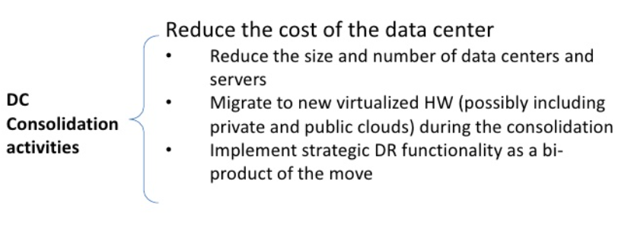
DATA CENTER CONSOLIDATION AND COLOCATION

Slide 11
DATA CENTER COLOCATION
Alternatively, data center operators can pay a fee to rent server space and other hardware in a colocation facility.
Colocation is an appealing option for organizations that want to avoid the large capital expenditures associated with building and maintaining their own data centers.
Today, colocation providers are expanding their offerings to include managed services, such as interconnectivity, allowing customers to connect to the public cloud.

Slide 12
BENEFITS OF DATA CENTER CONSOLIDATION
PHYSICAL LOCATIONS : Consolidating multiple physical locations can reduce operational expenses through lower energy consumption, fewer leases, and lower maintenance costs.
PROCUREMENT : Consolidation can reduce the quantity of necessary equipment such as servers, storage, and networking equipment. Indeed, this saves the organization significant procurement costs.
SOFTWARE : Consolidation of software onto fewer systems can reduce software licensing costs as well as maintenance costs

Slide 13
BENEFITS OF DATA CENTER CONSOLIDATION
ENVIRONMENTAL BENEFITS : It’s no secret that data centers are massive energy hogs (efficiency) and a large contributing factor to global warming.
Data center consolidations reduce total energy consumption, greatly reducing the carbon footprint of the organization.
SECURITY : Consolidating data centers improves security in a few ways.
You have fewer points of entry, for one.
You’re also reducing the total number of programs and systems to secure.
And, with less area to cover, avoiding vulnerabilities
REDUCE ERRORS : Complexity breeds errors. Data center consolidation simplifies processes like system discovery and network management.

Slide 14
AVOIDING THE RISKS OF DATA CENTER CONSOLIDATION
DISRUPTED EMPLOYEES
DATA LOSS
OPERATIONAL DOWNTIME

Slide 15
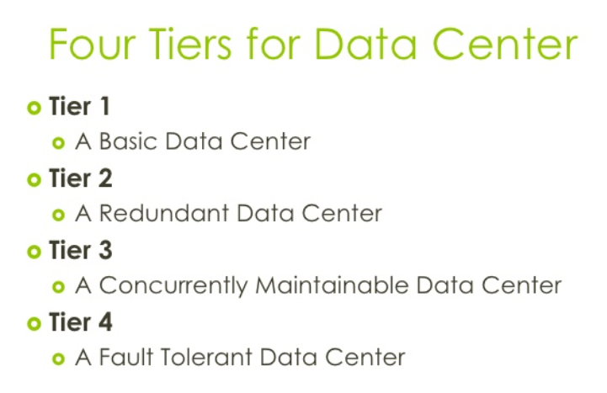
DATA CENTER TIERS

Slide 16
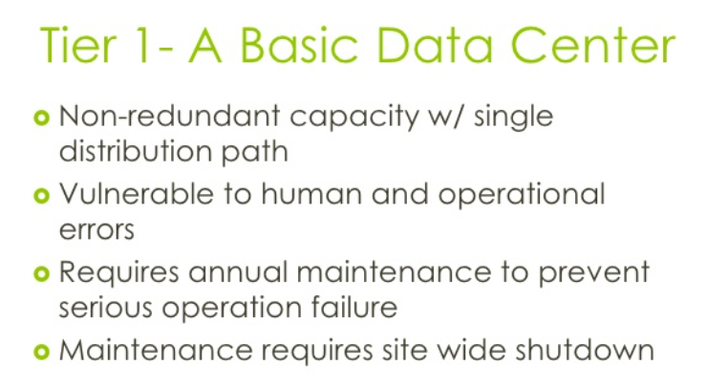
DATA CENTER TIERS

Slide 17
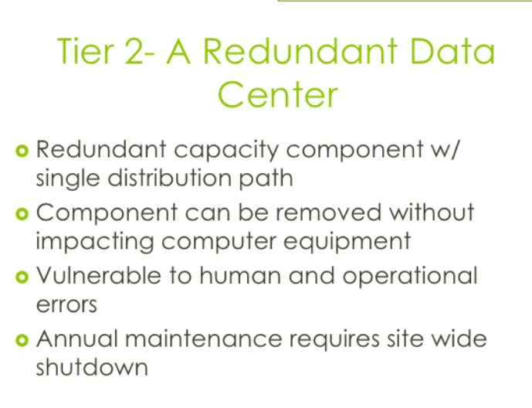
DATA CENTER TIERS

Slide 18
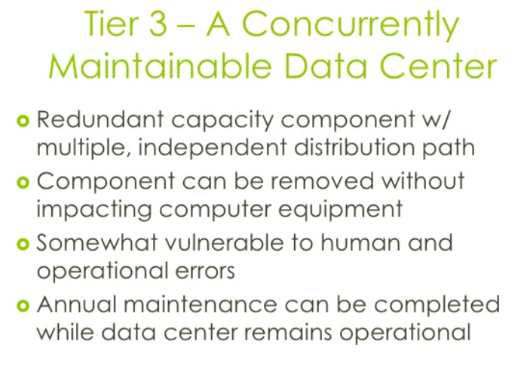
DATA CENTER TIERS

Slide 19
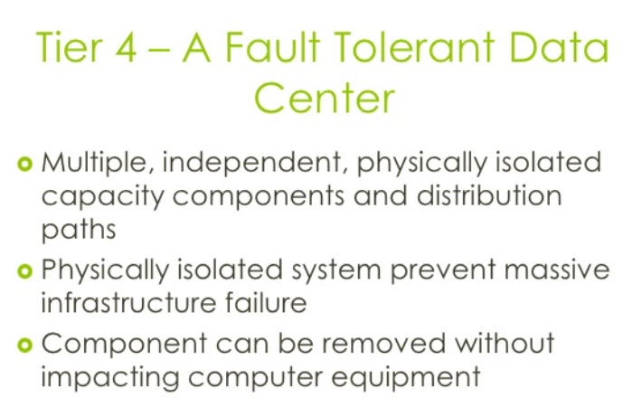
DATA CENTER TIERS

Slide 20
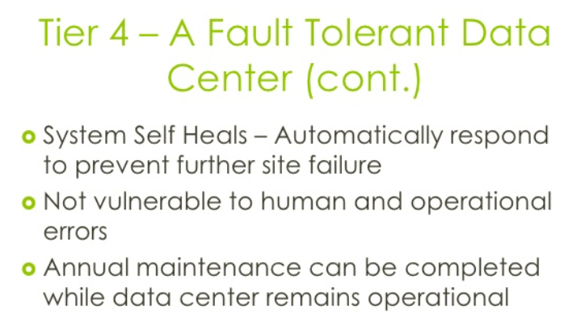
DATA CENTER TIERS

Slide 21
DATA CENTER ARCHITECTURE AND DESIGN
The data center is home to the computational power, storage, and applications necessary to support an enterprise business.
The data center infrastructure is central to the IT architecture, from which all content is sourced or passes through.
Proper planning of the data center infrastructure design is critical, and performance, resiliency, and scalability need to be carefully considered.

Slide 22
DATA CENTER ARCHITECTURE AND DESIGN
Another important aspect of the data center design is flexibility in quickly deploying and supporting new services.
Designing a flexible architecture that has the ability to support new applications in a short time frame can result in a competitive advantage.
Such a design requires solid initial planning and thoughtful consideration in the areas of port density, access layer uplink bandwidth, true server capacity, and oversubscription, to name just a few.

Slide 23
DATA CENTER ARCHITECTURE AND DESIGN
The data center network design is based on a proven layered approach, which has been tested and improved over the past several years in some of the largest data center implementations in the world.
The layered approach is the basic foundation of the data center design that seeks to improve scalability, performance, flexibility, resiliency, and maintenance.

Slide 24
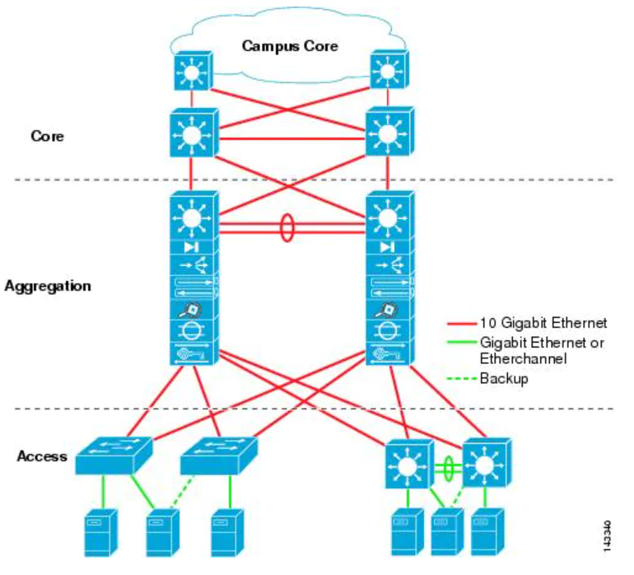

Slide 25
DATA CENTER DESIGN LAYERED APPROACH
Core layer—Provides the high-speed packet switching backplane for all flows going in and out of the data center. The core layer provides connectivity to multiple aggregation modules
Aggregation layer modules—Provide important functions, such as service module integration, Layer 2 domain definitions, Server-to-server multi-tier traffic flows through the aggregation layer and can use services, such as firewall and server load balancing, to optimize and secure applications.

Slide 26
DATA CENTER DESIGN LAYERED APPROACH
Access layer—Where the servers physically attach to the network. The access layer network infrastructure consists of modular switches, fixed configuration 1 or 2RU switches, and integral blade server switches.

Slide 27
DATA CENTER DESIGN MODELS
Multi-Tier Model
Server Cluster Model
Logical Overview
Physical Overview

Slide 28
ENERGY CONSUMPTION AND EFFICIENCY
Data center designs also recognize the importance of energy efficiency.
A simple data center may need only a few kilowatts of energy, but an enterprise-scale data center installation can demand tens of megawatts or more.
Organizations often measure data center energy efficiency through a metric called power usage effectiveness (PUE).
This PUE represents the ratio of total power entering the data center divided by the power used by IT equipment.

Slide 29
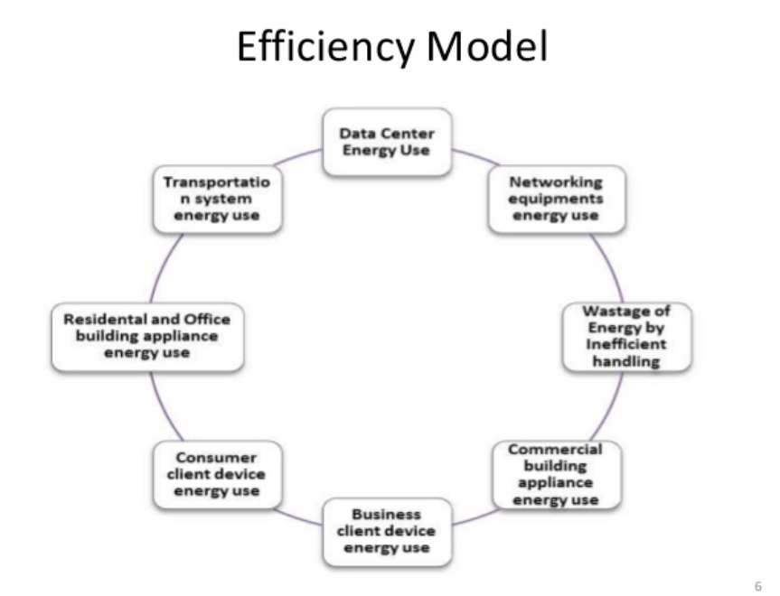

Slide 30
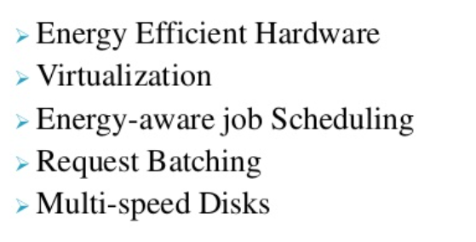
DIFFERENT APPROACHES FOR ENERGY EFFICIENCY

Slide 31
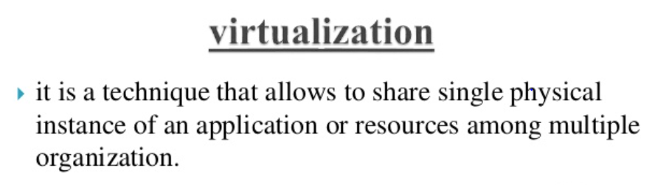
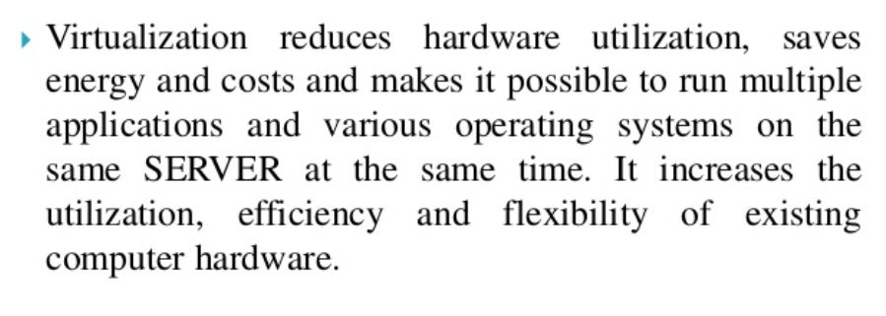
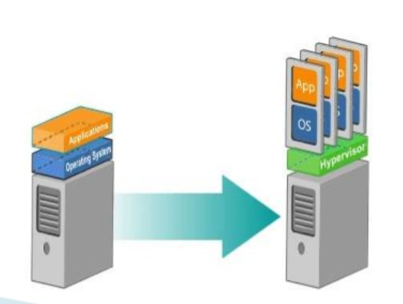

Slide 32
VIRTUALIZATION

Slide 33
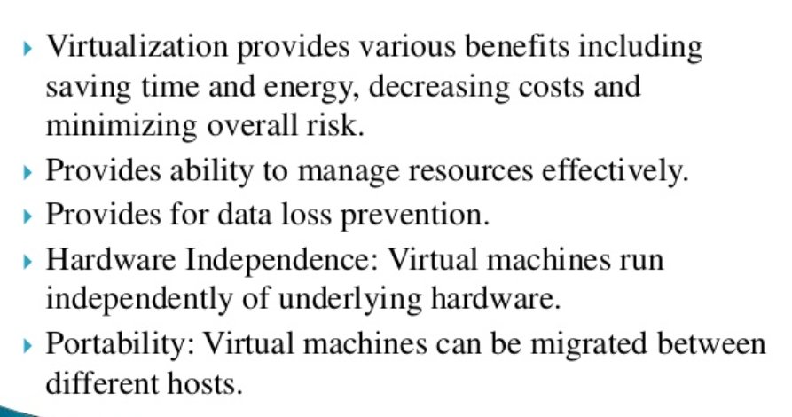
WHY DO WE NEED VIRTUALIZATION?

Slide 34
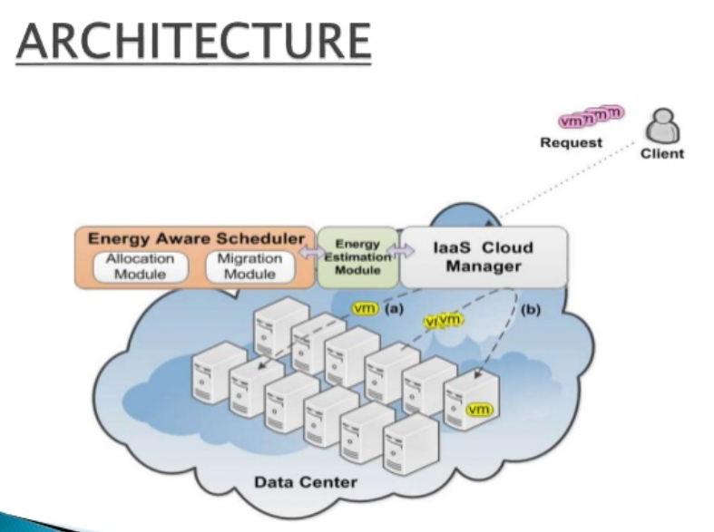

Slide 35
DATA CENTER SECURITY AND SAFETY
DATA CENTER SECURITY:
Data center security refers to the physical practices and virtual technologies used to protect a data center from external threats and attacks.
HOW TO SECURE A DATA CENTER?
Data centers are complex and to protect them, security components must be considered separately but at the same time follow one holistic security policy.
Security can be divided into physical and software security.

Slide 36
DATA CENTER SECURITY AND SAFETY
PHYSICAL SECURITY
A data center building’s most obvious security characteristics are related to design and layout.
SOFTWARE SECURITY
Software or virtual security prevents cybercriminals from entering the network by bypassing the firewall, cracking passwords, or through other loopholes.

Slide 37
WHO NEEDS DATA CENTER SECURITY?
Every data center needs some form of security to ensure its continued use.
Some aspects of “security” are actually made up of uptime features, such as multiple power sources, multiple environmental controls and more
Data centers can be placed into four tiers: each tier is associated with a specific business function and sets an appropriate criterion for cooling,

Slide 38
WHO NEEDS DATA CENTER SECURITY?
Tier 1 + 2
These are generally used by small businesses that do not provide real-time delivery of products or services as a significant part of their revenue.
Tier 3 + 4
Rigorous uptime requirements and long-term viability are usually the reason for selecting strategic solutions found in Tier III and Tier IV site infrastructure.
These data centers are considered more robust and less prone to failures.

Slide 39
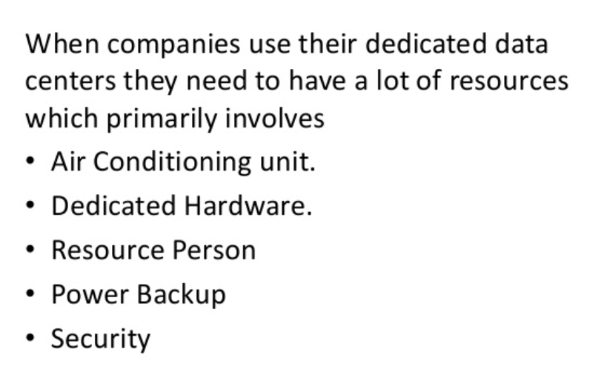
DATA CENTER ENERGY USE

Slide 40
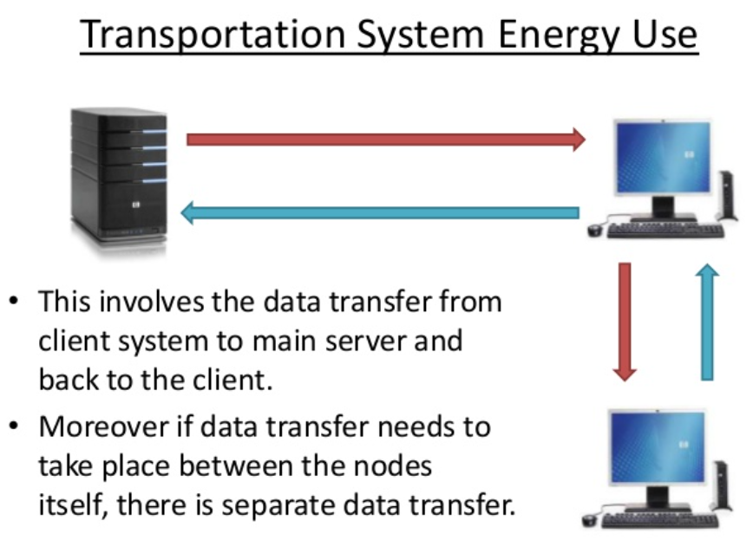
TRANSPORTATION ENERGY USE

Slide 41
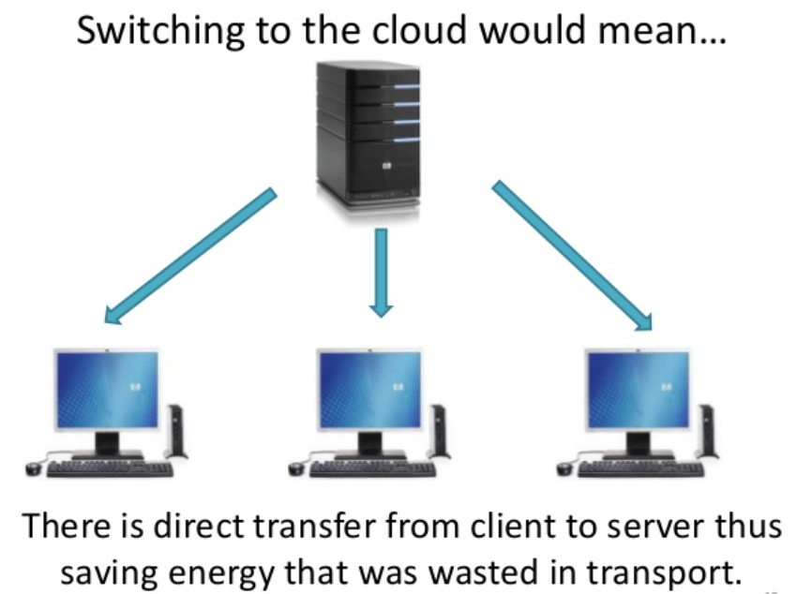
SWITCHING TO THE CLOUD – SAVING ENERGY

Slide 42
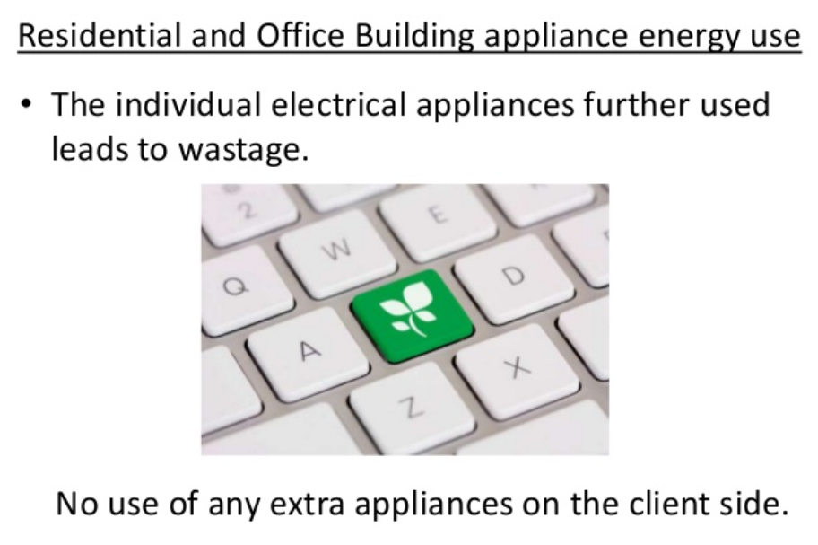

Slide 43
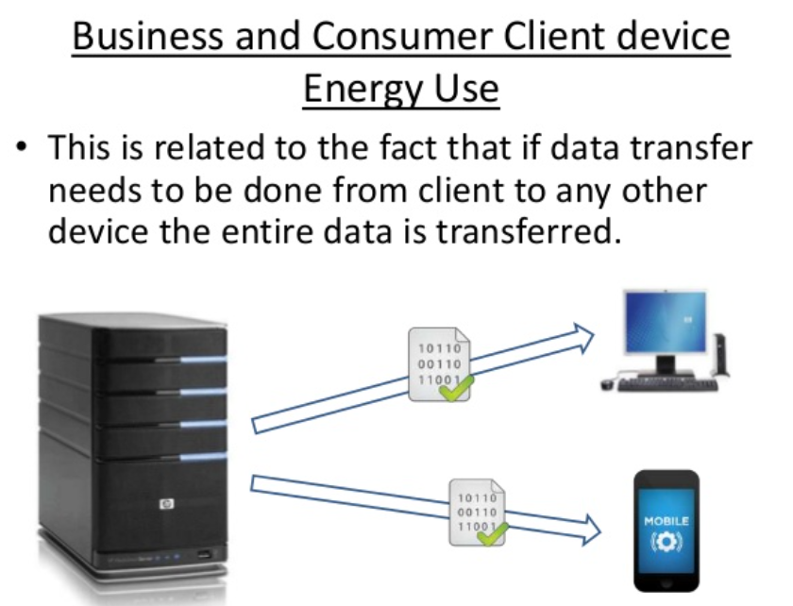

Slide 44
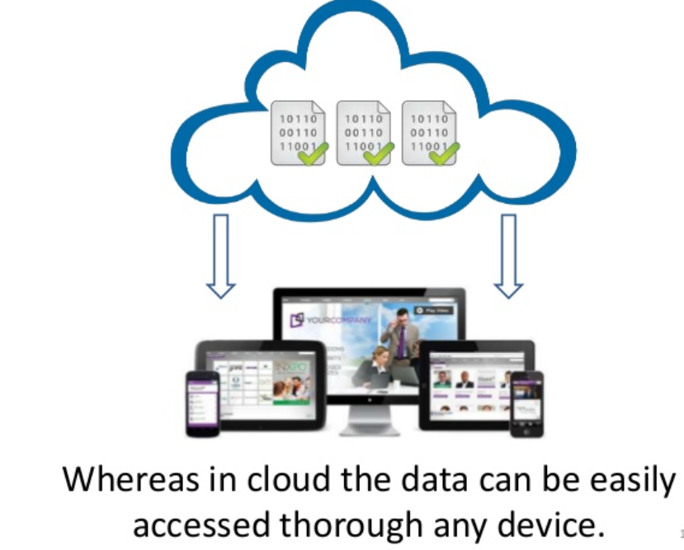

Slide 45
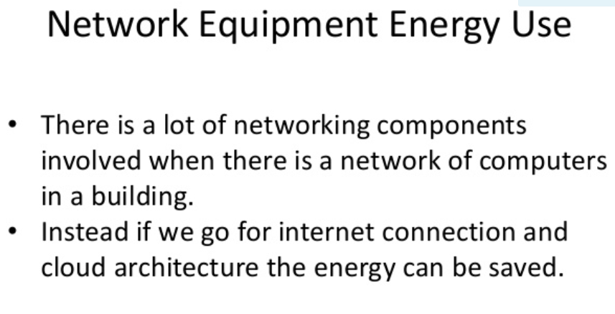

Slide 46
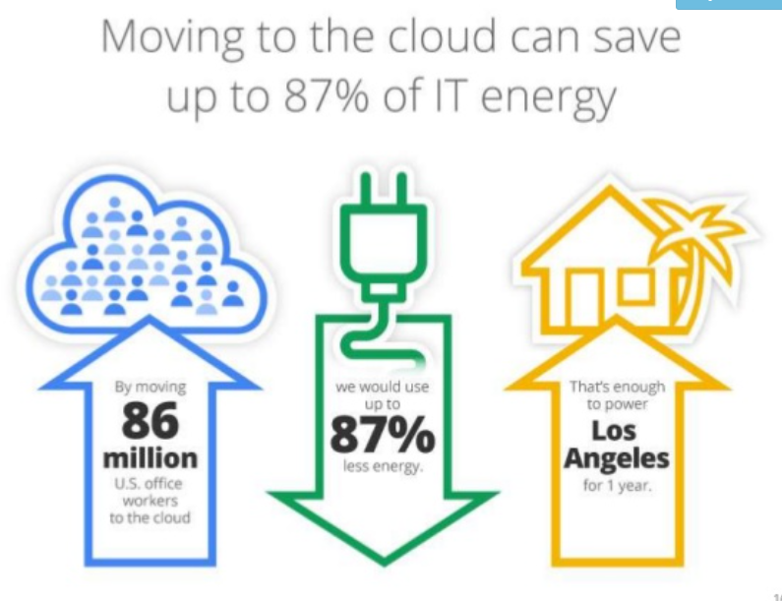

Slide 47
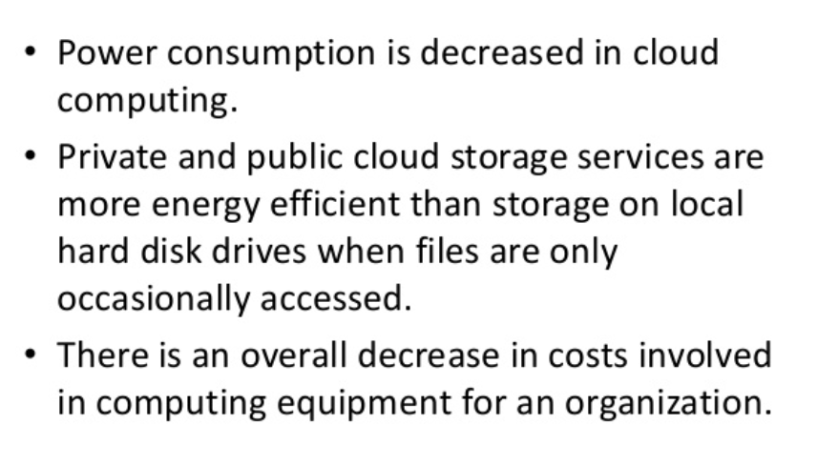
ENERGY CONSUMPTION

Slide 48
MOBILE CLOUD APPLICATION
What is Mobile Cloud Computing?
Mobile cloud computing (MCC) at its simplest, refers to an infrastructure where both the data storage and data processing happen outside of the mobile device.
Mobile cloud applications move the computing power and data storage away from the mobile devices and into powerful and centralized computing platforms located in clouds.
They are then accessed over the wireless connection based on a thin native client.

Slide 49
WHY MOBILE CLOUD COMPUTING?
Mobile devices face many resource challenges (battery life, storage, bandwidth etc.)
Cloud computing offers advantages to users by allowing them to use infrastructure, platforms and software by cloud providers at low cost and elastically in an on-demand fashion.
Mobile cloud computing provides mobile users with data storage and processing services in clouds, obviating the need to have a powerful device configuration (e.g. CPU speed, memory capacity etc), as all resource-intensive computing can be performed in the cloud.

Slide 50
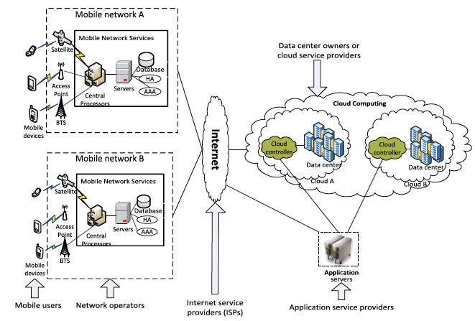
MCC ARCHITECTURE

Slide 51
MCC ARCHITECTURE
Mobile devices are connected to the mobile networks via base stations that establish and control the connections and functional interfaces between the networks and mobile devices.
Mobile users’ requests and information are transmitted to the central processors that are connected to servers providing mobile network services.
The subscribers’ requests are delivered to a cloud through the Internet.
In the cloud, cloud controllers process the requests to provide mobile users with the corresponding cloud services.

Slide 52
ADVANTAGES OF MCC
Extending battery lifetime
Improving data storage capacity and processing power
Improving reliability and availability
Dynamic provisioning
Scalability
Multi-tenancy
Ease of Integration

Slide 53
ADVANTAGES OF MCC
Dynamic provisioning:
Dynamic on-demand provisioning of resources on a fine-grained, self-service basis
No need for advanced reservation
Scalability:
Mobile applications can be performed and scaled to meet the unpredictable user demands
Multi-tenancy:
Service providers can share the resources and costs to support a variety of applications and large no. of users.
Ease of Integration:
Multiple services from different providers can be integrated easily through the cloud and the Internet to meet the users’ demands.

Slide 54
MCC APPLICATIONS
Mobile Commerce
Examples: Mobile financial, mobile advertising, mobile shopping…
M-commerce applications face various challenges (low bandwidth, high complexity of devices, security, …)
Integrated with cloud can help address these issues
Example: Combining 3G and cloud to increase data processing speed and security level.

Slide 55
MCC APPLICATIONS
Mobile Learning
M-learning combines e-learning and mobility
Cloud-based m-learning can solve these limitations
Enhanced communication quality between students and teachers
Help learners access remote learning resources

Slide 56
MCC APPLICATIONS
Mobile Healthcare:
Mobile Gaming
Assistive technologies
Other applications:
Sharing photos/videos
Keyword-based, voice-based, tag-based searching
Monitoring a house, smart home systems
……..

Slide 57
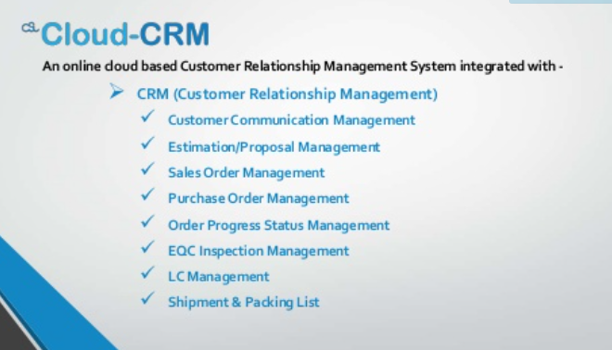
CRM MANAGEMENT

Slide 58
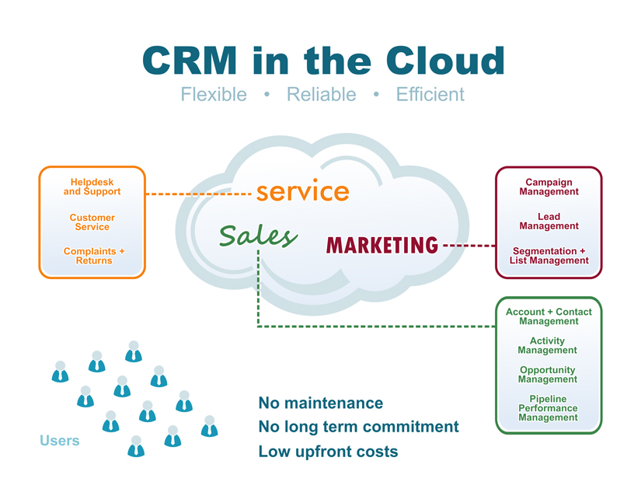
CRM IN CLOUD

Slide 59
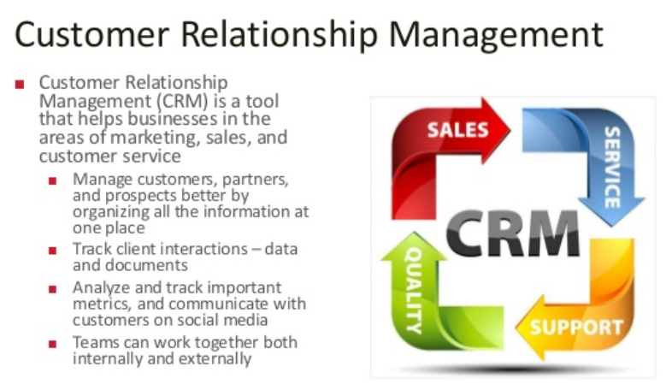

Slide 60
WHAT IS CRM?
Customer relationship management (CRM) describes all aspects of sales, marketing and service related interactions that a company has with its customers or potential customers
CRM Information, Tracking and Analytics
Information tracked in a CRM system might include contacts, sales leads, clients, demographic or firmographic data, sales history, technical support and service requests, and more.

Slide 61
CRM INFORMATION, TRACKING AND ANALYTICS
CRM systems can also automate many marketing, sales and support processes, helping companies provide a consistent experience to customers and prospects, while also lowering their costs.
Some CRM solutions also offer advanced analytics that offer suggested next steps for staff when dealing with a particular customer or contact

Slide 62
THE CUSTOMER RELATIONSHIP MANAGEMENT STRATEGY
Customer relationship management is a business strategy that enables companies to improve in the following areas:
Understanding existing customers' needs
Obtaining a 360-degree view of customers and prospects
Retaining customers through better customer experience and loyalty programs
Attracting new customers
Winning new clients and contracts
Increasing profitably
Decreasing customer management costs

Slide 63
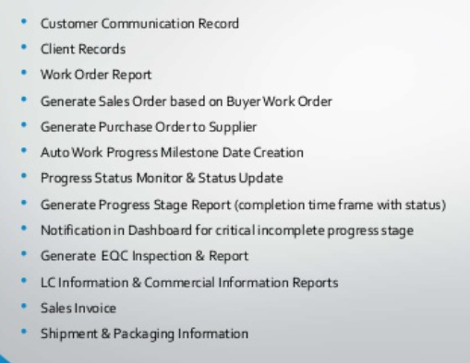
CRM SYSTEM COMPONENTS

Slide 64
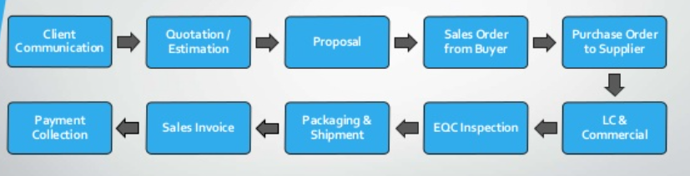
CRM BUSINESS PROCESS FLOW

Slide 65
PROJECT MANAGEMENT
With project management software hosted in the cloud, you can have everything you need at your fingertips, anywhere you happen to be.
There are three main approaches in project management.
Standardization
Harmonization
Integration

Slide 66
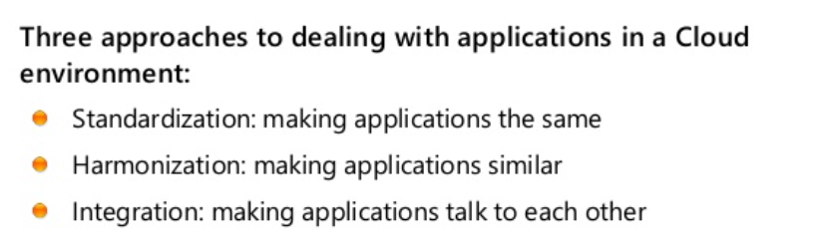
PM - STANDARDIZATION, HARMONIZATION & INTEGRATION

Slide 67
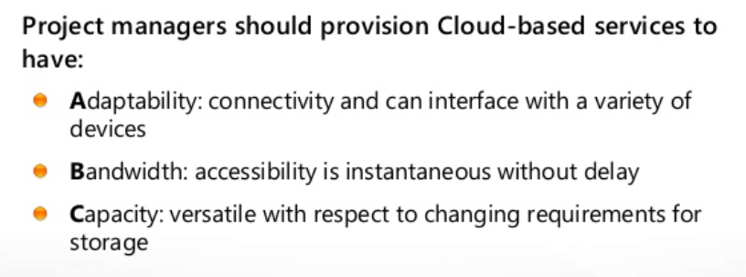
THE ABC’s OF PM PROVISIONING

Slide 68
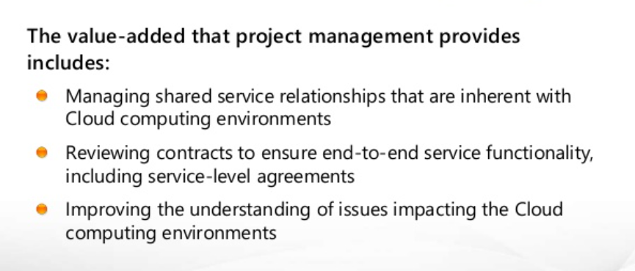
SHARED SERVICES FOR CLOUD COMPUTING
AFTER THE VENDOR SELECTION, THE PROJECT TEAM WILL DECIDE WHETHER TO CONSIDER THE CLOUD OR NOT.

Slide 69
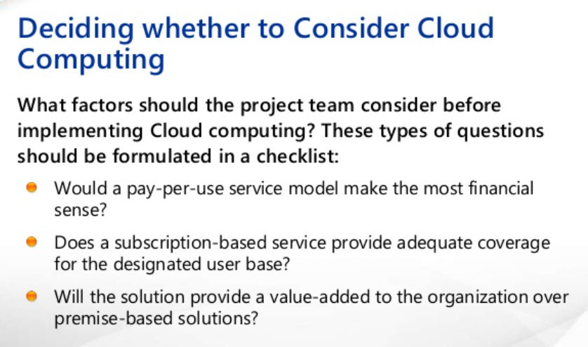

Slide 70
STEPS IN PROJECT MANAGMENT
Project communication management
Project cost management
Project human resource management
Project integration management
Project procurement management
Project quality management
Project risk management
Project scope management
Project time management

Slide 71
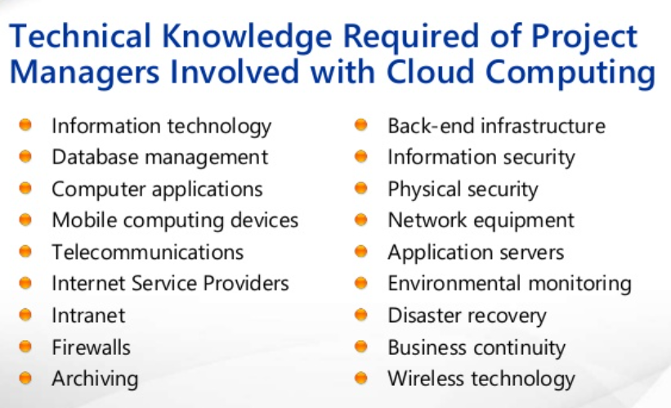

Slide 72
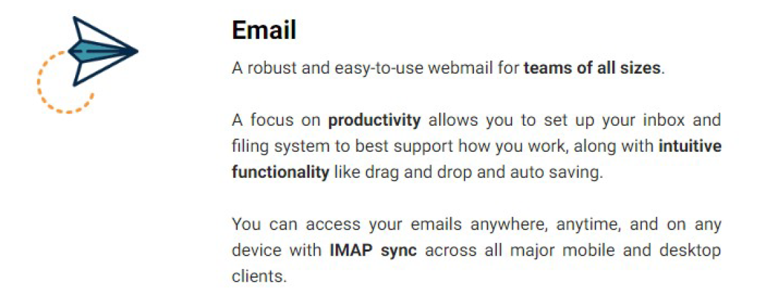
E-MAIL

Slide 73
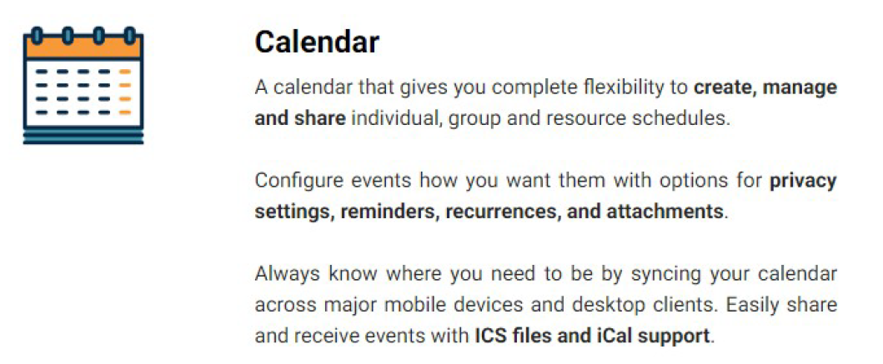
CALENDER

Slide 74
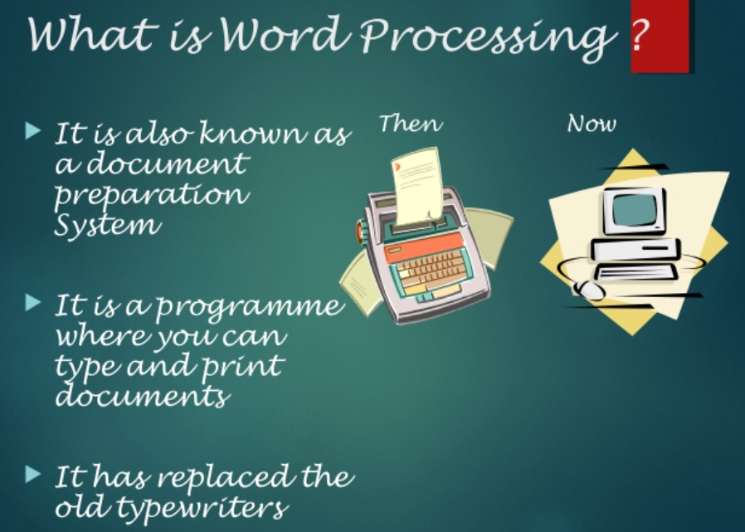
WORD PROCESSING

Slide 75
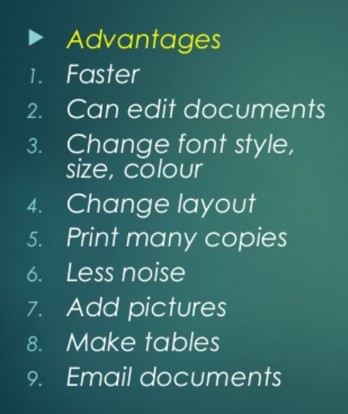
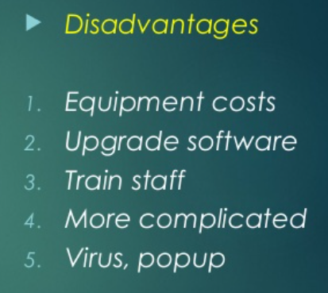
ADVANTAGES & DISADVANTAGES

Slide 76
WEB BASED WORD PROCESSING
How Web-Based Word Processing Works
Microsoft Word is a software program that is installed on your computer’s hard disk.
Web-based word processors, in contrast, are hosted in the cloud, not on your hard drive—as are the documents you create with these applications.

Slide 77
USERS FOR THE WEB BASED WORD PROCESSING
Beginning users.
Casual users.
Anyone who wants access to their documents from multiple locations.
Anyone who needs to share their documents with others.
Anyone who needs to edit their documents in a collaborative environment.

Slide 78
GOOGLE DOCS
Google Docs (docs.google.com) is the most popular web-based word processor available today.
Docs is actually a suite of applications that also includes Google Spreadsheets and Google Presentations; the Docs part of the Docs suite is the actual word processing application.
Like all things Google, the Google Docs interface is clean and, most important, it works well without imposing a steep learning curve.
Basic formatting is easy enough to do, storage space for your documents is generous, and sharing/collaboration version control is a snap to do.

Slide 79
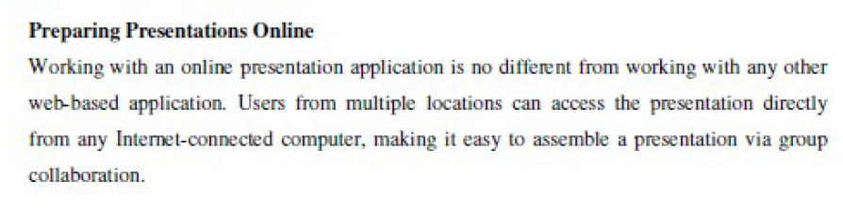
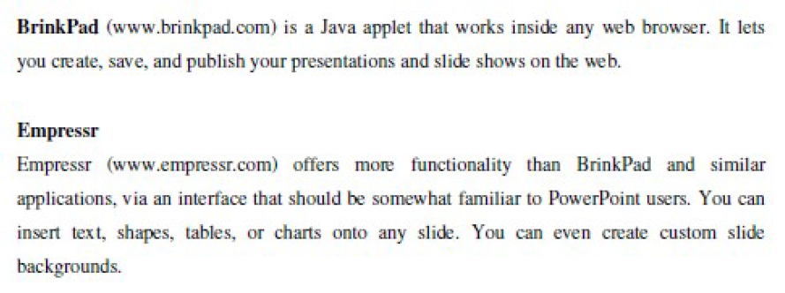
PRESENTATIONS

Slide 80
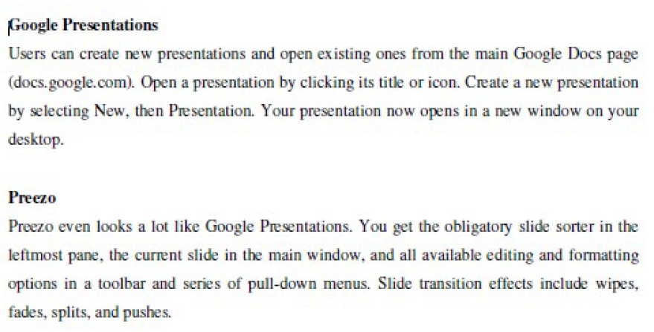
PRESENTATION ENGINE, PRE-ZENITT, THINKFREE, THUMBSTACKS, ZOHO SHOW.
THESE ARE THE OTHER WEB BASED WORD PRESENTATIONS.

Slide 81
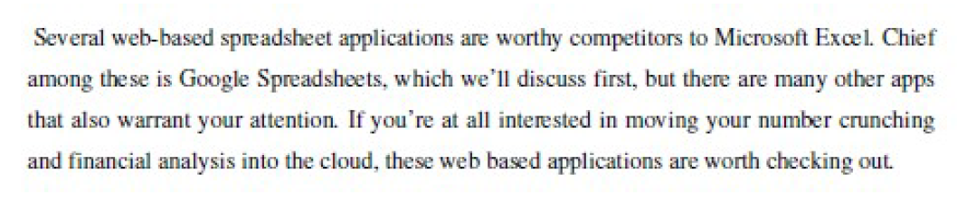
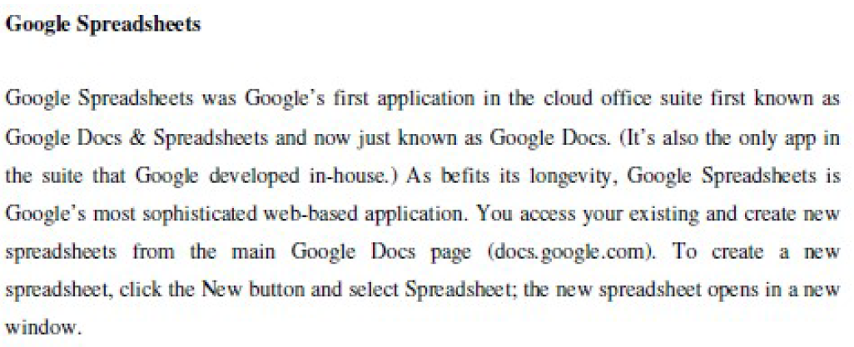
SPREADSHEETS

Slide 82
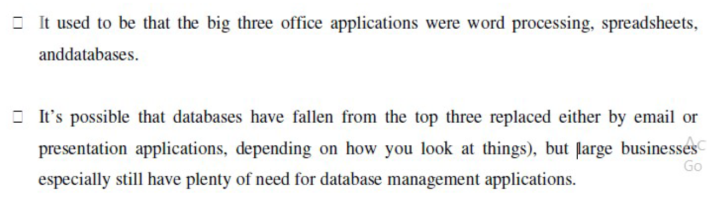
COLLABORATING ON DATABASES

Slide 83
COLLABORATING ON DATABASES
Understanding On Database Management
How Database Works
How Online Database Works

Slide 84
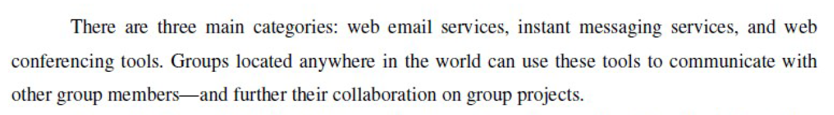
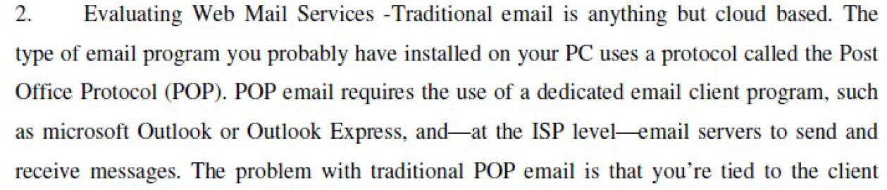
SOCIAL NETWORKS

Slide 85
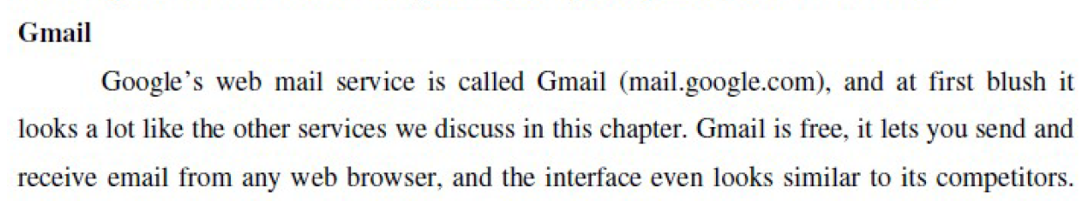
SOCIAL NETWORKS

